Slide 1
EuroMillions
A Winning Formula?
By: James Smith

Slide 2
ABOUT EUROMILLIONS
It is available to play in 9 countries – The UK being one of them
It Costs £2.50 for one play and there are two draws a week
A player picks Five numbers between 1-50 and Two Lucky Stars Between 1-12
The numbers are randomly selected via a machine
The biggest ever UK EuroMillions ticket winner was in July 2022 at £195,707,000
Making them richer than Sir Tom Jones
https://www.national-lottery.co.uk/games/euromillions/about-euromillions
(Accessed 25th November 2023)
https://www.bbc.co.uk/news/uk-62232071
(Accessed 25th November 2023)
Notes:
Just a short over view of what the EuroMillions is… It is a lottery draw
All the money in the prize pot is joined from these 9 countries
Two important lines

Slide 3
Data Set
I downloaded all EuroMillions draw results from the first draw on
February 13th 2004
To the latest available data available
on Kaggle, which was
31st October 2023
Date of Draw
Year of Draw
Month of Draw
Collections Made (In Spain)
Five Main Numbers
Two Lucky Stars
Euromillones Draw Numbers
https://www.kaggle.com/datasets/miguelminambres/euromillones-draw-numbers/
(Accessed 24th November 2023)
Notes:
Right… These are the columns in the data set
The data set is called: Euromillones Draw Numbers

Slide 4

A Question To Answer
Can I predict the lottery results?
Probably not…
But I can see which numbers are the most frequently pulled from the machine. That might give me a head start.

Slide 5
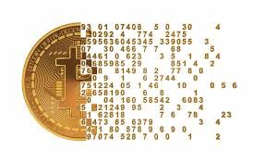
Problems with Data
Remove (Drop) the Month, Year, Date and Collections Made Columns.
I need to find a way to collect an average of the frequency of each ball drawn out of all the machine.
I thought a simple way of doing this would be to merge all the collum's and search which numbers appear the most.

Slide 6
What I did with the Data
LUCK OF THE DRAW REGARDING DATA
The data was formatted in my spreadsheet from lowest to highest and not draw order. This made it easier to work with.
Num_1 is always the lowest number drawn
Num_5 is the highest
This changed how I searched for the results
I Dropped the above mentioned collum’s
I searched for the Mean Average using the describe() function
I backed up this data by creating a count collum which counts the number of time a ball is drawn in each position (1-5)
Notes:
HOWEVER… When I looked at the Data… Due to data set I abandoned the merge and search idea

Slide 7
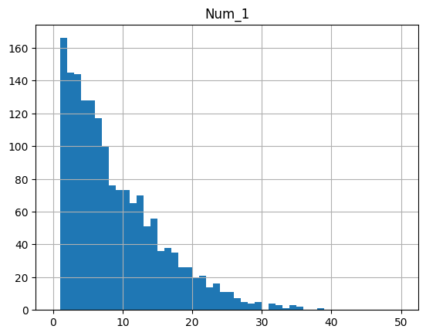
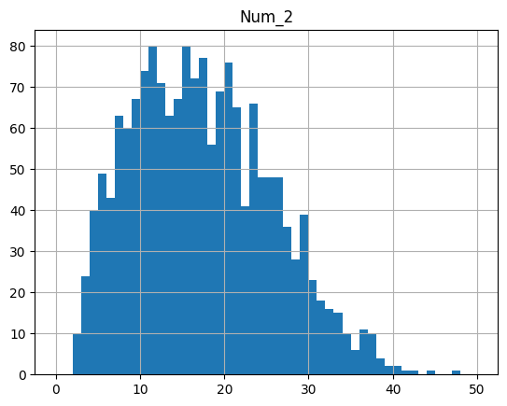
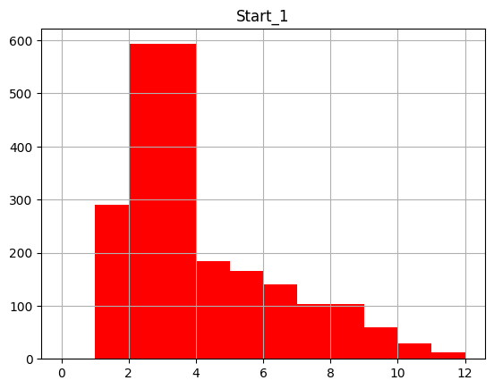
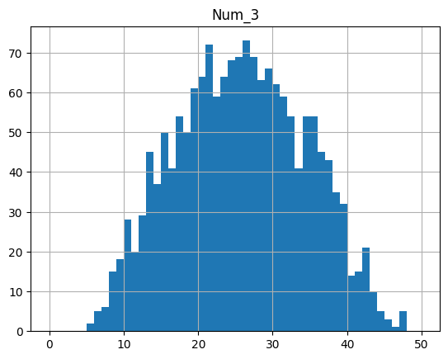
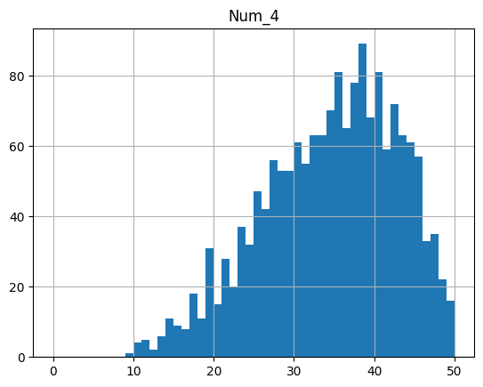
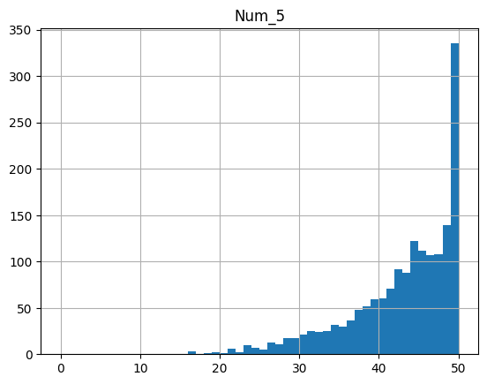
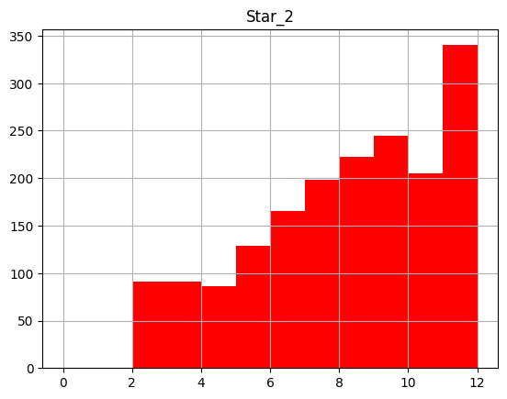
Here are the Results
mean 8.469363
mean 16.856038
mean 3.97204
mean 25.261154
mean 34.034503
mean 42.559786
mean 8.030934
Notes:
The Y axis shows number of times a ball was drawn and the X axis the balls number
The blue graphs are the five main balls (in order) and the red graphs are the two Lucky Stars

Slide 8
However
I decided to look at the data again
Back to that merge and search idea
I used the value_counts() function to count each number
Then added all the values for each draw together
This created a “count” off how many times each ball had been drawn

Slide 9
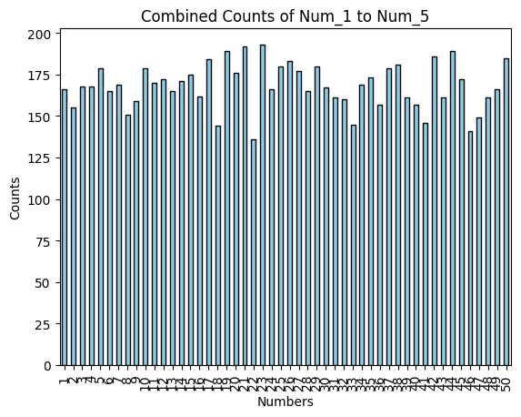
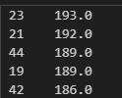
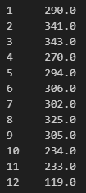


Alternative results
Notes:
Out of interest the bottom five numbers were 22, 46, 18, 33 & 41

Slide 10
Conclusions
50 balls in the draw
Its probably fair to say that the averages I found are roughly inline with multiple’s of 8
Other Trends
It appears from Graph 5 that there has never been a number below 16 drawn and Graph 1 there has never been a draw higher than 38.
So to have all six bottom numbers drawn the lowest outcome to date is all below 17 and the highest all above or matching 38.
The spread of data resembles how the data is formatted.
Notes:
Multiples of 10 would work well as a guestimate being an average equalling 50/5 = 10
Show the graphs
So all you are waiting for 1,2,3,4,5,6 to come out of the machine the lowest draw so far is up to 17

Slide 11
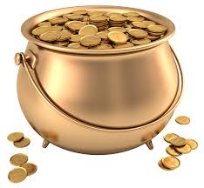
Improvements
An idea, calculate the mean average of winning jackpots to discover the average Euromillions winner’s winnings.
This data could not action this, I would need further information.
I do have a data error with ball 50 it has come out of the machine 185 times not nearly 350
Notes:
Collections made. Only applicable to Spain. AND IS NOT PRIZE JACKPOT. Always important to read the description of data on Kaggle
I did have an idea, if data was available, to calculate a mean average of winning jackpots to ascertain the average Euromillions winner’s takings

Slide 12
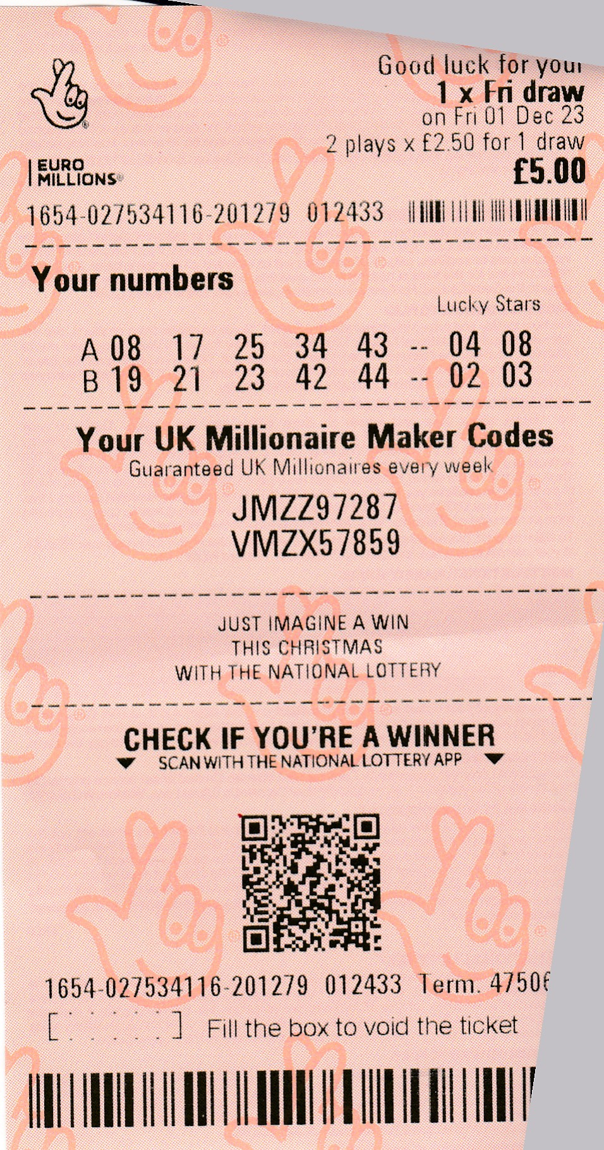

Ever the gambler I had to play the numbers:
8 , 17 , 25, 34, 43 4, 8
19, 21, 23, 42, 44 2,3
Images used within this project are from : https://clipart-library.com/
Any Questions?
Notes:
So in a nutshell we have numbers for the mean and numbers for the mode
Any Questions?

